Slide 1

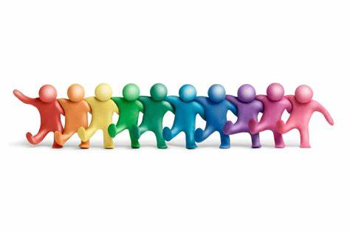
Year 5 Homework
Week 1
Hand in 24/04/26
This week you need to complete:
Be the Teacher Sheet
Maths Worksheet
Spellings
To read daily (aim for 20 minutes)
The Summer term is upon us! Keep up you amazing efforts and your achievements will follow ☺

Slide 2
Week 1 Spellings
Jalapeno
bargain | convenience | develop | explanation | government
lightning | parliament | restaurant | equipped | variety
Hot
soldier | variety | awkward | determined | equipped | opportunity
lightning | twelfth | equip | equipment | immediately | system
Spicy
twelfth | equip | equipment | system | forty
bargain | physical | rhythm | symbol | stomach
Mild
symbol | shoulder | fifty | graph | photo

